Slide 1
Water Pollution
Peter Ashford
Senior Lawyer, Environment Agency
November 2015

Slide 2
Outline
European Union law - the Water Framework Directive (2000/60/EC)
English legal regime

Slide 3
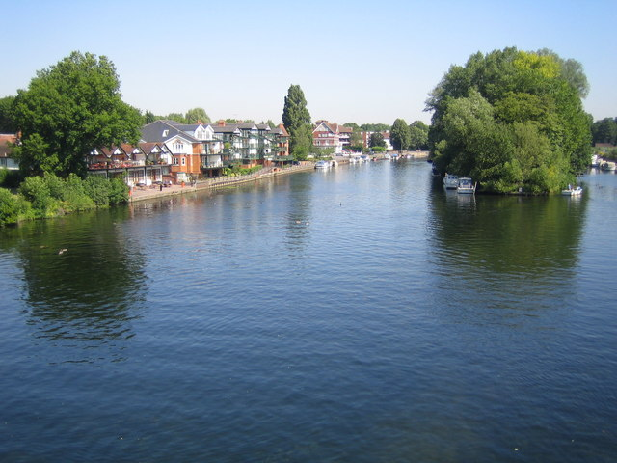
Copyright Nigel Cox under the Creative Commons Licence

Slide 4
Water Framework Directive
"The most ambitious item of environmental legislation to reach the European Union's statute book"
Article 1
The purpose of this Directive is to establish a framework for the protection of inland surface waters, transitional waters, coastal waters and groundwater, which:
prevents further deterioration and protects and enhances the status of aquatic ecosystems…
promotes sustainable water use...
aims at enhanced protection and improvement of the aquatic environment, inter alia, through specific measures for the progressive reduction of discharges, emissions and losses of priority substances...
ensures the progressive reduction of pollution of groundwater...
contributes to mitigating the effects of flooding and droughts...
© Rich Tea, licensed for reuse under a Creative Commons Licence

Slide 5
Water Framework Directive
Covers all "surface waters" and "groundwater"
Requires that Member States achieve certain, time-bound objectives
Establishes a strategic approach to achieving those objectives
Sets uniform methodologies for assessing whether or not the objectives are being met
Sets certain minimum requirements for the measures used, but largely leaves it up to Member States precisely how they achieve the objectives
Links to other Directives establishing "protected areas", eg by requiring compliance with the objectives of those Directives, where they relate to the water environment, at the same time as achieving WFD objectives
© Rich Tea, licensed for reuse under a Creative Commons Licence

Slide 6
WFD objectives (surface waters)
 | High
 | Good
 | Moderate
 | Poor
 | Bad
Progressively reduce pollution from priority substances and phase out emissions, discharges and losses of priority hazardous substances
Prevent status deterioration
Achieve Good status

Slide 7
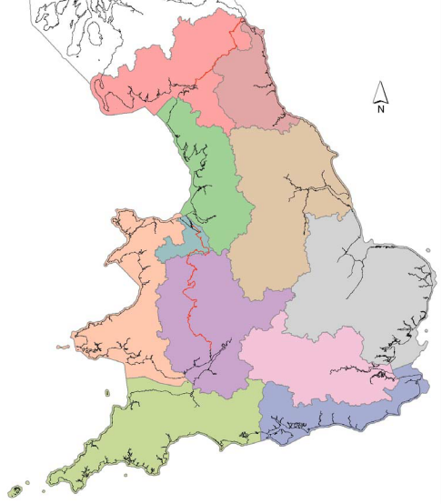
WFD strategic approach
Member States must establish, catchment-based "River Basin Districts"
Member States must produce integrated strategies for water management – "River Basin Management Plans"
The River Basin Management Plans:
  identify individual water bodies and their status
  identify pressures
  summarise programmes of measures
  are reviewed and updated every 6 years
  are drawn up after wide consultation and public participation

Slide 8
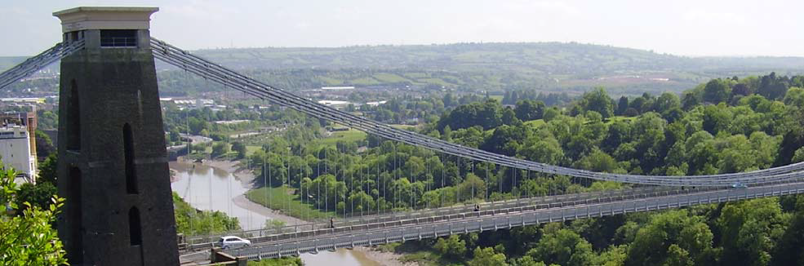
Waterbody Category and Map Code: | River - R68 | Surveillance site: Yes
Waterbody ID and Name: | GB109053027370 | R Avon (Brist) - conf Semington Bk to Netham Dam
National Grid Reference: | ST 79153 63541
Current Overall Potential | Poor
Status Objective (Overall): | Good by 2027 | (For Protected Area Objectives see Annex D)
Status Objective(s): | Good Ecological Potential by 2027, Good Chemical Status by 2027
Justification if overall objective is not Good Status by 2015: | Disproportionately expensive, Technically infeasible
Protected Area Designation: | Drinking Water Protected Area, Freshwater Fish Directive, Nitrates Directive, Urban Waste Water Treatment Directive
SSSI (Non-N2K) related: | No
Hydromorphological Designation: | Heavily Modified
Reason for Designation: | Navigation
Downstream Waterbody ID | GB530905415400

Slide 9
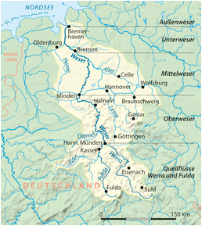
Bund für Umwelt und Naturschutz Deutschland eV v Bundesrepublik Deutschland Case C-461/13
Member States are required, unless a derogation is granted, to refuse authorisation for an individual project where it may cause a deterioration of the status of a body of surface water or where it jeopardises the attainment of "Good" status
"Deterioration" should be interpreted as at least one of the quality elements, falling by one class, even if that fall does not result in a fall in classification of the body of surface water as a whole.
If the quality element concerned, is already in the lowest class, any deterioration of that element constitutes a 'deterioration' for the purposes of the Directive.
Copyright NordNordWest under the Creative Commons License

Slide 10
WFD beyond 2015
Deadline to meet the objectives is 22 December 2015
This may be extended for no more than two 6-year periods (i.e. until 2027) (save where natural conditions require further extension)
Conditions for extension:
  all necessary improvements cannot be achieved in time because of technical feasibility, disproportionate expense or natural conditions
  an updated River Basin Management Plan explains the reasons for the extension and summarises the measures proposed to bring the water bodies to the required status by the extended deadline and the timetable for doing so
  no further deterioration occurs in the status of the affected water bodies
Major project over 2015 to assess all water body classifications, then update all RBMPs to cover the period 2015 to 2021.

Slide 11
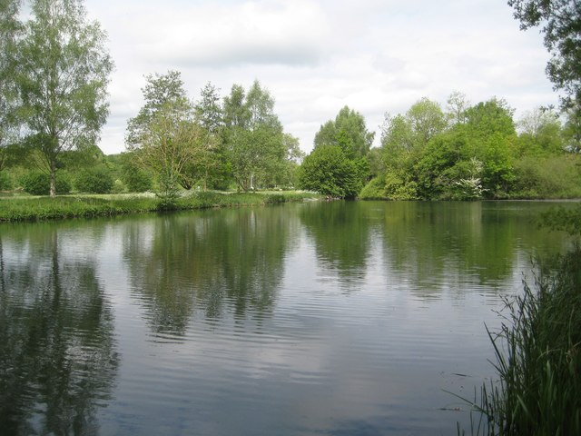
Copyright Nigel Cox under the Creative Commons Licence

Slide 12
Water pollution - English law
Water Environment (Water Framework Directive) (England and Wales) Regulations 2003
Water Resources Act 1991
Environmental Permitting (England and Wales) Regulations 2010
Environment Act 1995
Control of Pollution (Oil Storage) (England) Regulations 2001
Water Resources (Control of Pollution) (Silage, Slurry and Agricultural Fuel) (England) Regulations 2010
The Nitrate Pollution Prevention Regulations 2015
The Environmental Damage (Prevention and Remediation) (England) Regulations 2015

Slide 13
Environmental Permitting Regulations
Section 12 General Prohibition – "a person must not... cause or knowingly permit a water discharge activity or a groundwater activity"
Permit Defence – discharges under, and to the extent authorised by, a permit are not prohibited
Regulatory Control – permits & permit conditions
  WFD "basic measures" to achieve its objectives include: "...a requirement for prior authorisation... laying down emission controls for the pollutants concerned..."
  Allows control over who obtains a permit and oversight of their activity
  Contain emissions controls based on BAT / emission limit values / EU Directive requirements
  Set by reference to receiving water body and WFD classification, so support achieving WFD objectives

Slide 14
Environmental Permitting Regulations
Meaning of "causing" a water discharge activity
  A strict liability offence; no mens rea necessary
  A person can be guilty, even if the discharge happens because of:
    natural events, Alphacell Ltd v Woodward (1972)
    agents, Attorney General’s Reference (No 1 of 1994) (1995)
    unforeseeable equipment failures, Environment Agency v Brock plc (1998)
    trespassers, Empress Car Company (Abertillery) Ltd v National Rivers Authority (1998)
Meaning of "poisonous, noxious or polluting matter"
Very widely construed by the courts, following the ordinary natural meaning of "pollute"
It can include:
    oil, eg Empress Car
    soil, R v Dovermoss Ltd (1995)
    milk, Express Dairies v Environment Agency (2003)

Slide 15
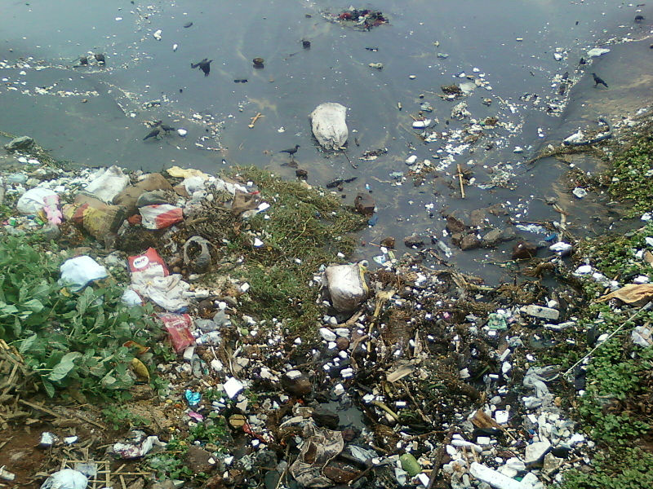
Criminal Sanctions
  Criminal offence to contravene the General Prohibition
  punishable by up to 5 years imprisonment and an unlimited fine
Copyright Adityamadhav83 under the Creative Commons License

Slide 16
Sentencing
Pre-2014:
R v Thames Water Utilities Ltd [2010] EWCA Crim 202
Court of Appeal reduced the fine from £125,000 to £50,000
Post-2014
R v Thames Water Utilities Ltd [2015] EWCA Crim 960
Court of Appeal upheld a fine of £250,000
Signalled that fines could, in some circumstances, amount to 100% of pre-tax profits and that fines in excess of £100m are not inconceivable

Slide 17
Thank you

