Slide 1
Environmental Law- Lecture 13: Protected Areas at Sea
Dr Margherita Pieraccini (m.Pieraccini@Bristol.ac.uk)

Slide 2
Outline
Intro to the marine environment
Designation of an ecologically coherent network of MPAs
Management of MPAs
England in focus: an assessment of domestic marine conservation law

Slide 3
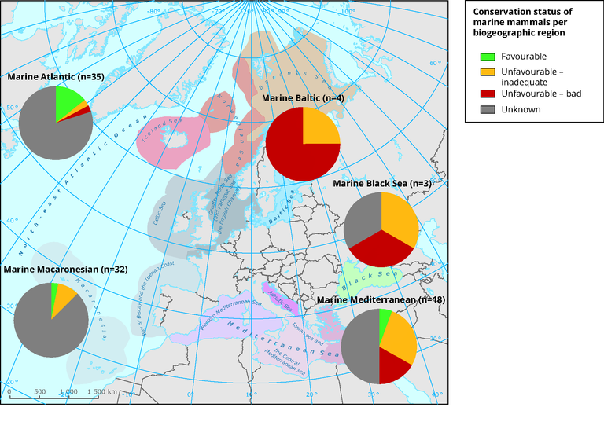
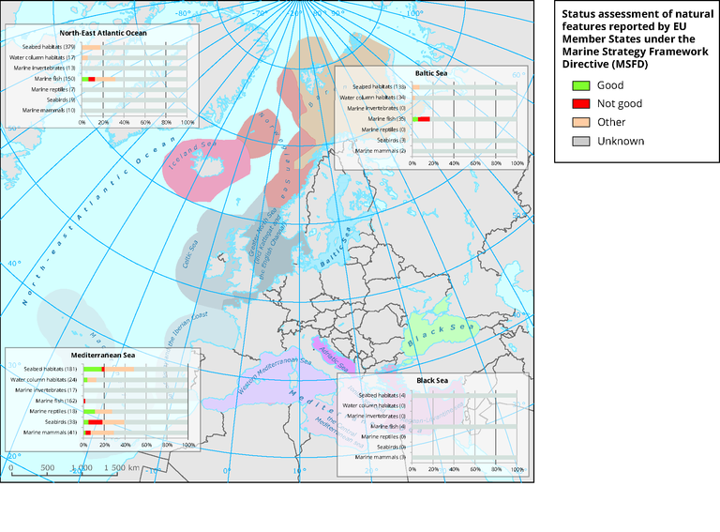
The status of Oceans in Europe
Source EEA 2015

Slide 4
The complexities of the marine environment
Ecological complexities:
  The dynamism of the sea
  The high scientific uncertainty surrounding marine environments
  The wider context of global environmental change
Social complexities:
  Absence of a structured system of property rights
  Presence of many stakeholders: commercial fisheries, various industries (aggregates, renewables..), recreational groups, public often with conflicting interests

Slide 5
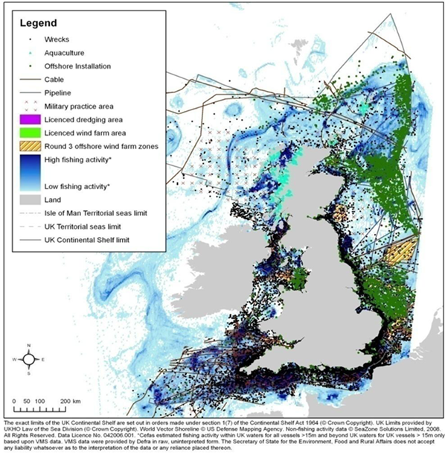
A Busy Sea: UK

Slide 6
So…
How best can conservation law establish MPAs in an environment with no well-defined natural boundaries?
How can MPAs be established in a way that does not unjustly undermine stakeholders’ interests and ecological values?

Slide 7
Establishing an ecological coherent network of MPAs: international calls
Johannesburg Plan of Implementation of the 2002 World Summit on Sustainable Development’s call for establishing “marine protected areas consistent with international law and based on scientific information, including representative networks by 2012”
Decision VII/5 of the COP 7 of the Convention of Biological Diversity acknowledges the Johannesburg Plan in that it focused on the importance of establishing representative networks of marine protected areas by 2012

Slide 8
Establishing an ecological coherent network of MPAs: international calls
OSPAR Convention: Article 3 (1)(b)(ii) requires the OSPAR Commission “to develop means, consistent with international law, for instituting protective, conservation, restorative or precautionary measures related to specific areas or sites or related to particular species or habitats”.
As a follow up, the Commission recommended the establishment of an ecologically coherent network of MPAs (Recommendation 2003/3 as amended by Recommendation 2010/2)

Slide 9
Network of MPAs and EU Law
Directive 2008/56/EC (Marine Strategy Framework Directive)
Para 6 of the preamble mentions MPAs as a key tool to conserve the environment and to contribute to the achievement of Good Environmental Status (GES)
GES: Key term in the Directive. Art 1(1) states that the Directive establishes a framework within which Member States shall take the necessary measures to achieve or maintain good environmental status (GES) in the marine environment by the year 2020 at the latest
Art 13(4): “programmes of measures established pursuant to this Article shall include spatial protection measures, contributing to coherent and representative networks of MPAs…”
Note: OSPAR measures for establishing MPAs are brought under the scrutiny of the European Commission and the EU Court of Justice

Slide 10
What about other existing networks?
Recall…..Natura 2000 network: an ecologically coherent network composed of natural habitat types listed in Annex I and of habitats for species listed in Annex II - known collectively as special areas of conservation (SACs) and Special Protection Areas (SPAs) under the Wild Birds Directive
Natura 2000 sites can be established also offshore- see Commission v UK, Case C-6/04, [2005] ECR 1-5261.

Slide 11
Natura 2000 in the sea
Marine European sites are the weakest link of the Natura 2000 network, as recognized by the European Commission
Weakness of N200 also visible by comparing it with OSPAR criteria

Slide 12
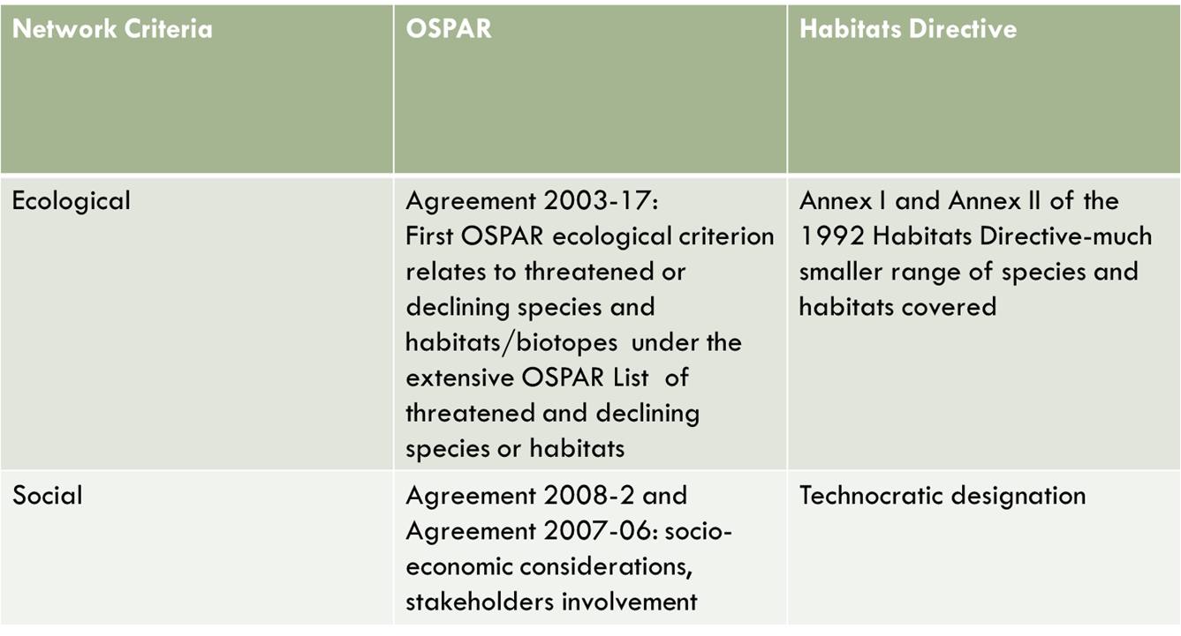
OSPAR vs. Natura 2000

Slide 13
English Approach towards the network
S 123 of the Marine and Coastal Access Act 2009: Creation of a network of MPAs that include:
  Marine Conservation Zones established under s 116 MCAA
  European marine sites (SACs and SPAs under Habitats and Wild Birds Directives)
  Ramsar sites under the Convention on Wetlands of International Importance Especially as Waterfowl Habitat 1971
  The marine component of SSSIs

Slide 14
English Approach towards the network
a) That the network contributes to the conservation or improvement of the UK marine environment;
b) that it is representative of the range of features in the UK marine environment;
c) that the conservation of a feature may require the designation of more than one site
Cf. Art 3 Habitats Directive: to maintain or restore species and habitats under the Natura 2000 network at a favourable conservation status. (No mention of conditions!)

Slide 15
English Approach to the Network
Reporting Obligation (s 124): including positive obligations (as the report should also contain any further steps that should be taken to achieve this objective and the conservation objectives stated for any MCZ)
Cf. Reporting Obligations under the Habitats Directive (Art 17)-only focuses on assessment/evaluation
Hence, the MCAA seems to offer a more detailed approach to marine conservation than the Habitats Directive.
But has English marine conservation law always been stronger than its European counterpart in practice?

Slide 16
Domestic law prior to the MCAA
Marine Nature Reserves: s. 36 and s. 37 of the Wildlife and Countryside Act 1981
Section 36(1) empowered the Secretary of State to designate by order marine natural reserves on an application made by nature conservation body.
Marine nature reserves could stretch only to 3 nautical miles from the coast and designated for 1)the purpose of conserving marine biodiversity or 2) marine research

Slide 17
Domestic law prior to the MCCA
Designation order should be accompanied by a copy of the proposed byelaws made by the conservation body
Criticisms:
  Slow process of designation: only 3 in total ever designated!
  Scope of the byelaws very limited
  No provisions for connectivity→ ecological islands
  Very technocratic designation

Slide 18
Designation of MCZs under the MCAA
S 36 and 37 of the WCA are repealed and MNR replaced by Marine Conservation Zones (MCZs)
MCZs are to be designated for the conservation of any a) marine flora and fauna, b) marine habitats or types of marine habitats, c) features of geological or geomorphological interest (s 117(1)).
The designation order should contain Conservation Objectives for protected features
MCZs designation may take into account socio-economic consequences of designation! See s 117(7). Is this positive? Cf. Habitats Directive and cases Case C-371/98 ex parte First Corporate Shipping Ltd and C-226/08 - Stadt Papenburg v Bundersrepublik Deutchland)

Slide 19
Implementation of Part V
Ecological Network Guidance (ENG) by JNCC and NE: Guidelines for the network design principles of representatively, replication, adequacy and connectivity
Concretizing s 117(7): 4 Regional Projects led by stakeholders and guided by the conservation aims set by the ENG (boundaries adjusted to minimize socio-economic consequences) and reviewed by Scientific Advisory Panel→ 127 MCZs proposed including more than 60 Reference Areas
Designation in tranches

Slide 20
Assessing the English Approach to designation: a successful integration of socio-economic issues?
1. Socio-economic considerations during the participatory stakeholder working groups (South-East case study)
2. Impact Assessments (IAs): effective and reflexive regulation tools?

Slide 21
1. Socio-economic interests and participation
The Environment Audit Committee 2014 Report stated that “the statutory provision which allows socio-economic considerations to be taken into account has made the process of designation a contested one”.
Why?
  Participants put in pre-determined categories (livelihood, ecology…);
  Socio-economic consequences primarily considered as costs;
  Ecological Network Guidance canonised what counted as the ecological;
  Participants were stakeholders, not deliberants: compromise and bargain at the core of the process.
  See: http://ecologiesandidentities.blogs.ilrt.org/

Slide 22
2. Impact Assessments
Another way in which socio-economic issues were considered was through IAs.
IAs have become central in UK regulatory improvement strategies in the past three decades and are in line with government’s aim to cut the red tape.
The Department for Business, Innovation and Skills (2011) defines IAs as both “a continuous process to help think through the reasons for government intervention, to weight up various options for achieving an objective and to understand the consequences of a proposed intervention; and a tool to be used to help develop policy by assessing and presenting the likely costs and benefits and the
associated risks of a proposal that may have an impact on the public, business or civil society organisations, the environment and wider society over the long term”

Slide 23
Impact Assessments
evidence-based processes informing decisions via cost-benefit analysis, forecasting the future consequences of current regulatory choices (“regulatory foresight”)
Policy-makers are not the only ones to be informed by IAs as an important part of IAs is the potential for public scrutiny.
Underlying assumption is that CBA is the best measure of public policy

Slide 24
IAs for tranche 1 MCZ
IAs used in the first tranche of MCZs designation raise questions of procedural and substantive legitimacy
Three critiques:
1. IAs as a simplifying tool
2. Uncertainty
3. Transparency issues

Slide 25
IAs as a simplifying tool
The potential positive impacts of MCZs were not quantified and the positive and negative impacts kept entirely separate in the IA report.
Uniform 75% displacement figure was adopted for all MCZs regardless of legal and geographical specificities (e.g. size of boats/ICES zones, other designations).

Slide 26
Uncertainty
Process of designating MCZs permeated by managerial and scientific uncertainty;
How to model potential socio-economic costs if the activities that could be carried out in the MCZs were unknown? A best estimate figure representing impact was derived from the range by setting a mid point between high and low cost scenarios for each type of fishing gear (scenarios are extreme)

Slide 27
Transparency issues
How did IAs for MCZs fulfilled transparency and accountability requirements?
IAs, produced by project economist, were not subject to full debate during the stakeholders working groups “some people never heard anything about the IA until the very last meetings.” (fisherman, South-East)
The calculations in the IAs were features based but by the time the IA was put out for consultation, the government had made the decision to designate on the basis of a fraction of the original features proposed yet the IAs reports still show the impact on all features.

Slide 28
Management of MCZs under the MCAA
Marine Management Organization (MMO) has powers to:
  Make byelaws for furthering the conservation objectives of MCZs (s 129). Provisions can include prohibiting/restricting the entry into or movement of people and animals or particular activities (also in nearby areas)/issue permits to conduct otherwise illegal activities/differentiate among areas within MCZs, time of the year, methods to carry out an activity
  Make emergency byelaws for 12 months if there is an urgent need to protect an MCZ (s 131) or interim byelaws (s 132) if there is an urgent need to protect the area that in the opinion of the MMO that the area should be designated.
Inshore Fisheries Conservation Authorities have management and enforcement powers for MCZs within their district up to 6nm

Slide 29
Offences
It is an offence to contravene byelaws (s 139)
Strict liability to damage a protected features of MCZs. Damaging includes killing/injuring animals that are a protected feature under the MCZ, picking/cutting/destroying habitats (s 140(2)).
However, also note the civil sanctions’ route under s 142(1): The Secretary of State may by order make provisions to confer on enforcement authority the power to impose a fixed monetary penalty

Slide 30
Conclusion
MPAs are an important tool to protect the sea
The creation of an ecologically coherent network allows for the consideration of the interconnectedness of the sea
Natura 2000 network in the marine environment is not enough
Domestic approach through the establishment of MCZs adds to N2000 both ecologically and socially in theory but in practice the designation process has been fraught with difficulties and an assessment of the management is too early to make.

